Slide 1
Context Free Grammar

Slide 2
Topics to be covered
Chomsky hierarchy
Context free grammar
Recursive definition
FA to regular grammar
Derivation
Ambiguity & unambiguous grammar
Simplified forms & normal forms
CFG to CNF
Union, Concatenation & Kleene’s of CFG

Slide 3
Chomsky Hierarchy

Slide 4
Chomsky hierarchy (Classification of grammar)
Grammar
Unrestricted grammar (type 0)
Restricted grammar
Context sensitive grammar (type 1)
Context free grammar(type 2)
Regular grammar(type 3)

Slide 5

Type 0 grammar (Phrase Structure Grammar)
Their productions are of the form:
$$α → β$$
$α$ is (V+T)* V (V+T)* $β$ is (V+T)*
V=Variable / Non-Terminal
T=Terminal
It is also known as unrestricted grammar.
Example: S → ACaB
Bc → acB
CB → DB
aD → Db
S → ε

Slide 6
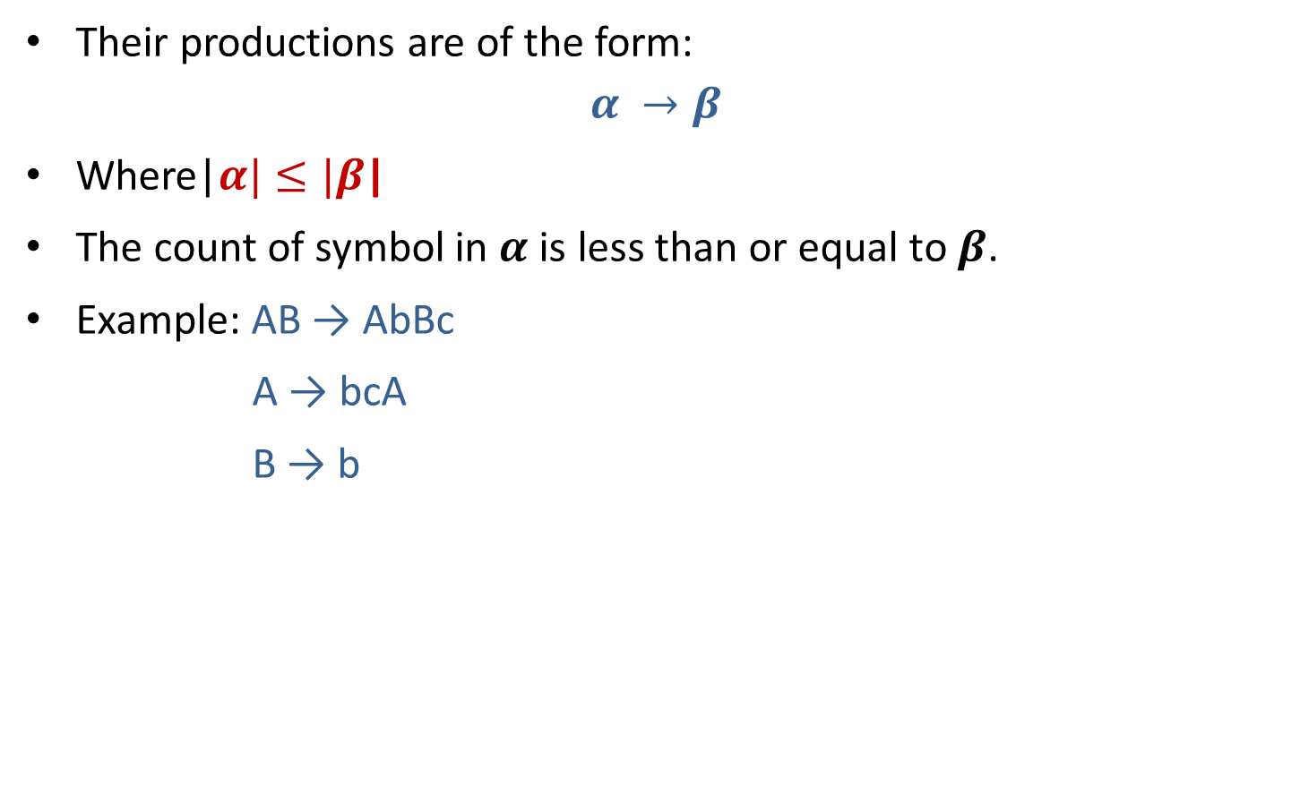
Type 1 grammar (Context Sensitive Grammar)
Their productions are of the form:
$$α →β$$
Where|$α|≤|β$|
The count of symbol in $α$ is less than or equal to $β$.
Example: AB → AbBc
A → bcA
B → b

Slide 7

Type 2 grammar (Context Free Grammar)
Their productions are of the form:
$$α →β$$
Where |$α|=1 and there is no restriction on β$.
Example: S → Xa
X → a
X → aX
X → abc

Slide 8
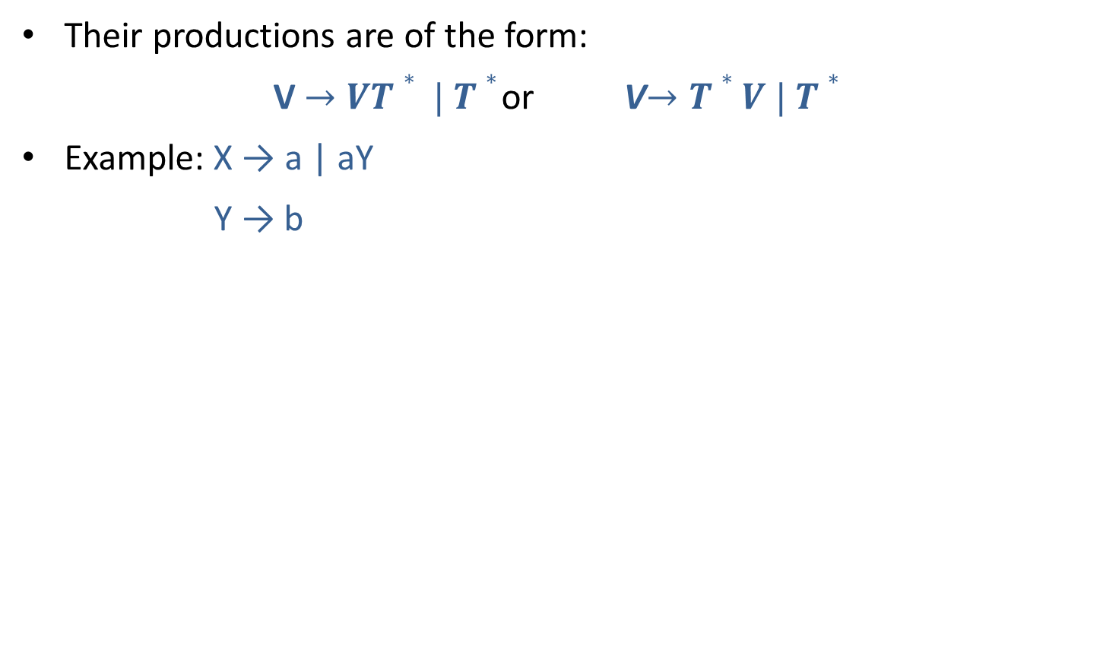
Type 3 grammar (Regular grammar)
Their productions are of the form:
V$→VT∗ | T∗$ or V$→T∗V | T∗$
Example: X → a | aY
Y → b

Slide 9

Summary

Slide 10
Hierarchy of grammar
Type 0(Phrase structure)
Type 1(Context sensitive)
Type 2(Context free)
Type 3 (Regular)

Slide 11
Grammar

Slide 12
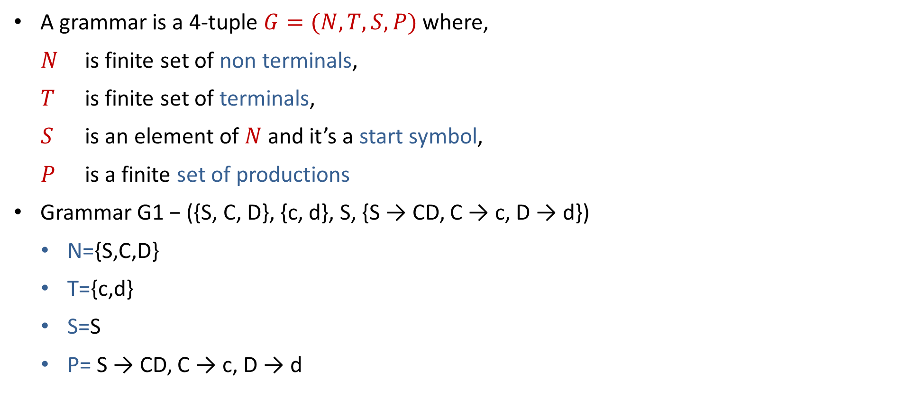
Grammar
A grammar is a 4-tuple $G=(N,T,S,P)$where,
$N$ is finite set of non terminals,
$T$ is finite set of terminals,
$S$ is an element of $N$ and it’s a start symbol,
$P$ is a finite set of productions
Grammar G1 − ({S, C, D}, {c, d}, S, {S → CD, C → c, D → d})
N={S,C,D}
T={c,d}
S=S
P= S → CD, C → c, D → d

Slide 13
Derive String from Grammar
Grammar G = ({S, C}, {c, d}, S, {S →cCd, cC → ccCd, C → ε } )
S ⇒ cCd using production S →cCd
⇒ccCdd using production cC →cCd
⇒cccCddd using production cC→ cCd
⇒cccddd using production C→ ε

Slide 14
Context Free Grammar

Slide 15

Context Free Grammar
A context free grammar (CFG) is a 4-tuple $G=(N,T,S,P)$where,
$N$ is finite set of non terminals,
$T$ is finite set of terminals,
$S$ is an element of $N$ and it’s a start symbol,
$P$ is a finite set of productions of the form $A →α$ where $A∈N$ and $α ∈ {(N ∪T)}^{∗}$.

Slide 16
Context Free Grammar
Application of CFG:
CFG are extensively used to specify the syntax of programming language.
CFG is used to develop a parser.

Slide 17
Generating Strings with CFGs
Start with the initial symbol
Repeat:
Pick any non-terminal in the string
Replace that non-terminal with the right-hand side of some rule that has that non-terminal as a left-hand side
Until all elements in the string are terminals

Slide 18
Generating Strings with CFGs
S → aS
S → Bb
B → cB
B → Ɛ
Generating a string:
S replace S with aS
aS replace S with Bb
aBb replace B with cB
acBb replace B with Ɛ
acb Final String

Slide 19
Generating Strings with CFGs
S → aS
S → Bb
B → cB
B → Ɛ
Generating a string:
S replace S with aS
aS replace S with aS
aaS replace S with Bb
aaBb replace B with cB
aacBb replace B with cB
aaccBb replace B with Ɛ
aaccb Final String

Slide 20
Generating Strings with CFGs
S → aS | Ɛ
Possible strings={Ɛ, a, aa, aaaa, aaaa, ….}
S → bS | Ɛ
Possible strings={Ɛ, b, bb, bbb, bbbb, ……}
S → aS | bS | Ɛ
Possible strings={Ɛ, a, b, aa, bb, ab, aba, bbab, …..}

Slide 21
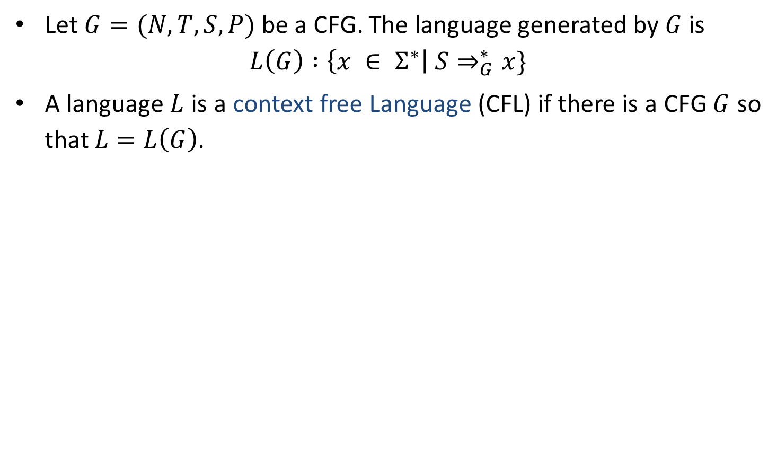
Context Free Language
Let $G=(N,T,S,P)$ be a CFG. The language generated by $G$ is
$$L\left(G\right) :\left\{x ∈ Σ^{∗}\right| S⇒_{G}^{∗}x\}$$
A language $L$ is a context free Language (CFL) if there is a CFG $G$ so that $L=L\left(G\right)$.

Slide 22
CFG Examples
Write CFG for either a or b
S→a | b
Write CFG for a⁺
S→ aS | a
Write CFG for a*
S→ aS | ^
Write CFG for (ab)*
S→abS | ^
Write CFG for any string of a and b
S→ aS | bS | a | b

Slide 23
CFG Examples
Write CFG for ab*
S→aX
X→˄| bX
Write CFG for a*b*
S→XY
X→aX|˄
Y→bY|˄
Write CFG for (a+b)*
S→aS | bS | ^
Write CFG for a(a+b)*
S→aX
X→aX | bX | ^

Slide 24
CFG Examples
Write CFG for a* | b*
S→A | B
A→˄| aA
B→^ |bB
Write CFG for (011+1)*(01)*
S→AB
A→011A | 1A | ^
B→01B | ^
Write CFG for balanced parenthesis
S→ [] | {} | [s] | {s} | ^

Slide 25
CFG Examples
Write CFG which contains at least three times 1.
S→A1A1A1A
A→0A | 1A | ^
Write CFG that must start and end with same symbol.
S→0A0 | 1A1
A→0A | 1A | ^
The language of even & odd length palindrome string over {a,b}
S→aSa|bSb|a|b|˄
No. of a and no. of b are same
S→aSb|bSa|SS|˄
The language of {a, b} ends in a
S→aS | bS |a

Slide 26
CFG Examples
Write CFG for regular expression (a+b)*a(a+b)*a(a+b)*
S→XaXaX
X→aX|bX|˄
Write CFG for number of 0’s and 1’s are same (n₀(x)=n₁(x))
S→0S1 | 1S0 |SS| ^
Write CFG for L={a^{i} b^{j} c^{k} | i=j or j=k} S -> S1|S2
For i=j for j=k
S1→AB S2→CD
A→aAb | ab C→aC | a
B→cB | c D→bDc | bc

Slide 27
CFG Examples
Write CFG for L={ a^{i}b^{j}c^{k} | j>i+k}
S→ABC
A→aAb |˄
B→bB | b
C→bCc |˄
Write CFG for L={ 0^{i}1^{j}0^{k} | j>i+k}
S→ABC
A→0A1 |˄
B→1B | 1
C→1C0 |˄
Write CFG for the language of Algebraic expressions
S→S+S | S*S | S-S | S/S | (S) | a

Slide 28
CFG Examples
CFG for syntax of programming language
<statement> $→$ … | <if-statement> | <for-statement> | …
<if-statement> $→$ if ( <expression> ) <statement>
<for-statement> $→$ for ( <expression>; <expression>; <expression> ) <statement>

Slide 29
Recursive Definitions

Slide 30
Recursive Definitions
Recursive Definition of {a,b}*
˄∈L.
For any S∈L, aS∈L.
For any S∈L, bS∈L.
No other strings are in L.
Recursive Definition of Palindrome
˄, a, b ∈ L
For any S ∈ L , aSa ∈ L and bSb ∈ L
No other string are in L
Recursive Definition of the language {a^{n}b^{n} | n≥0}
˄∈ L
For every S ∈ L, aSb ∈L
No other strings are in L
CFG: S→ aS | bS | ^
CFG: S→ aSa | bSb | a | b | ˄
CFG: S→ aSb | ˄

Slide 31
FA to Regular Grammar

Slide 32










FA to Regular Grammar
0
1
$$A→0A$$
0
$$A→1B$$
$$A$$
1
$$B$$
$$C$$
$$B→0C$$
$$B→1B$$
1
$$C→0A$$
0
$$C→1B$$
$$B→0$$
At last, all the incoming transitions to the accepting states are designated by the production
Source State → input symbol

Slide 33
Exercise: FA to Regular Grammar
b
a
B
a
b
A
b
C
b
b
a
a
E
a
D

Slide 34
Generating Strings with CFGs
E → E+ E| E – E |a | b
Derive string “a-b+a”
Generating a string:
E E
E-E E+E
a-E E-E+E
a-E+E a-E+E
a-b+E a-b+E
a-b+a a-b+a

Slide 35
Generating Strings with CFGs
S→0S1S | 1S0S | Ɛ
Derive string “011100”
Generating a string:
S
0S1S
01S
011S0S
0111S0S0S
01110S0S
011100S
011100

Slide 36
Derivation

Slide 37
Derivation
The process of deriving a string is called as derivation.
There are two types of derivation:
Leftmost derivation
Rightmost derivation

Slide 38
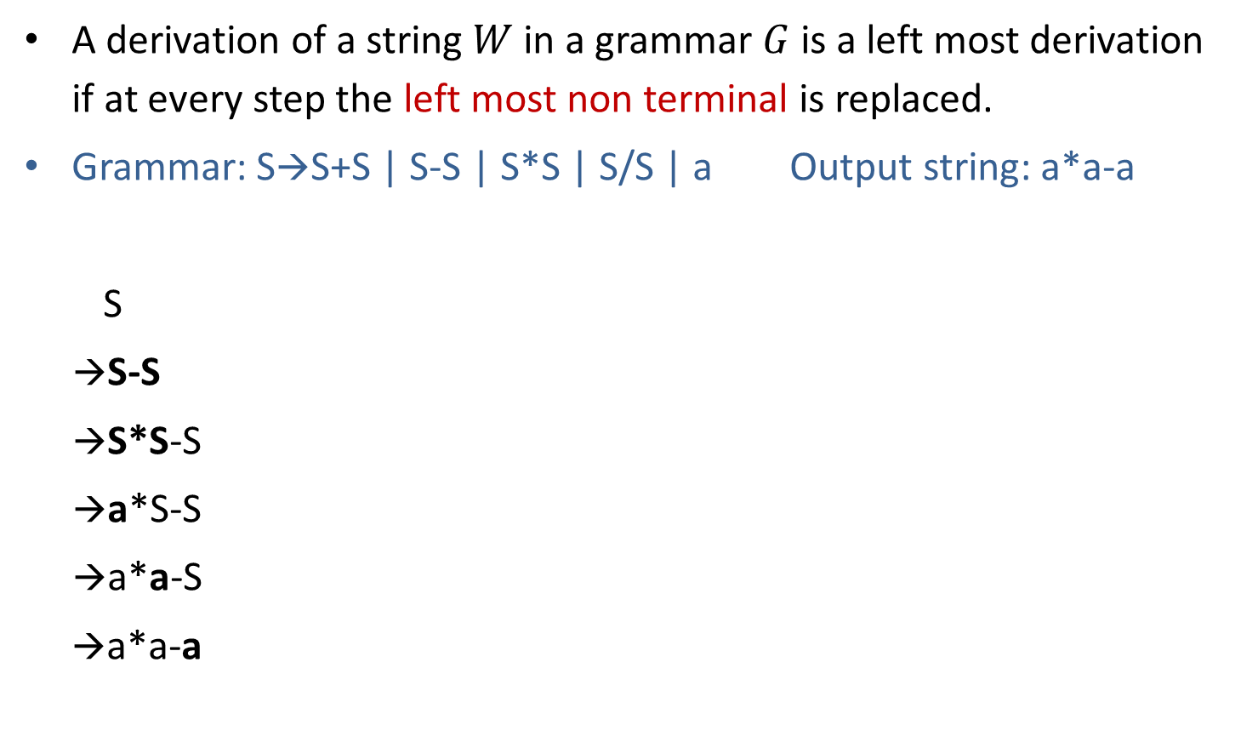
Leftmost derivation
A derivation of a string $W$ in a grammar $G$ is a left most derivation if at every step the left most non terminal is replaced.
Grammar: S→S+S | S-S | S*S | S/S | a Output string: a*a-a
S
→S-S
→S*S-S
→a*S-S
→a*a-S
→a*a-a
S
S
-
S
Parse tree represents the structure of derivation
S
*
S
a
a
a
Parse tree
Leftmost Derivation

Slide 39
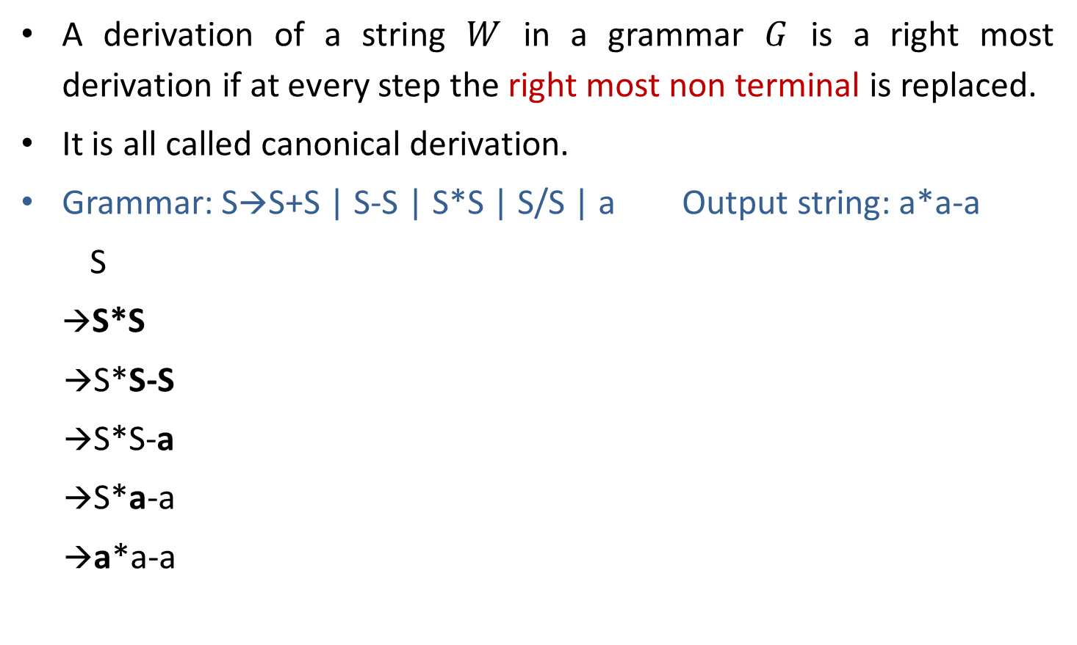
Rightmost derivation
A derivation of a string $W$ in a grammar $G$ is a right most derivation if at every step the right most non terminal is replaced.
It is all called canonical derivation.
Grammar: S→S+S | S-S | S*S | S/S | a Output string: a*a-a
S
→S*S
→S*S-S
→S*S-a
→S*a-a
→a*a-a
S
S
*
S
a
S
-
S
a
a
Parse Tree
Rightmost Derivation

Slide 40
Example: Derivation
S→A1B
A→0A | 𝜖
B→0B | 1B | 𝜖 Perform leftmost & Rightmost derivation.
(String: 00101)
Leftmost Derivation
S
A1B
0A1B
00A1B
001B
0010B
00101B
00101
Rightmost Derivation
S
A1B
A10B
A101B
A101
0A101
00A101
00101

Slide 41
Parse Tree
The graphical representation of a derivation is called as a parse tree or derivation tree.
Grammar: S→S+S | S-S | S*S | S/S | a Output string: a*a-a
S
S
*
S
a
S
-
S
a
a
Parse Tree

Slide 42
Parse Tree
The root node is always a node indicating start symbols.
The derivation is read from left to right.
The leaf node is always terminal nodes.
The interior nodes are always the non-terminal nodes.
S
S
*
S
a
S
-
S
a
a
Parse Tree

Slide 43
Exercise: Derivation
Perform
1) Leftmost derivation and rightmost derivation.
2) Draw parse tree.
S→A1B
A→0A | 𝜖
B→0B | 1B | 𝜖
Output string: 1001.

Slide 44
Ambiguous grammar

Slide 45
Ambiguous grammar
Ambiguous grammar is one that produces more than one leftmost or more then one rightmost derivation for the same sentence.
Grammar: S→S+S | S*S | (S) | a Output string: a+a*a
S S
→S*S →S+S
→S+S*S →a+S
→a+S*S →a+S*S
→a+a*S →a+a*S
→a+a*a →a+a*a
Here, Two leftmost derivation for string a+a*a is possible hence, above grammar is ambiguous.
S
S
S
*
S
S
+
S
S
S
a
a
S
*
S
+
a
a
a
a

Slide 46
Exercise: Ambiguous grammar
Check whether following grammar is ambiguous or not:
E→ I
E→ E +E
E → E * E
E → ( E )
I → 0 | 1 | 2 | … |9 | 𝜖
String: 3*2+5

Slide 47
Exercise: Ambiguous grammar
Check whether following grammars are ambiguous or not:
S→ aS | Sa | 𝜖 (string: aaaa)
S→ aSbS | bSaS | 𝜖 (string: abab)
S→SS+ | SS* | a (string: aa+a*)

Slide 48
Unambiguous grammar
Grammar: S→ S+S | S*S | (S) | a
Equivalent unambiguous grammar is
S→ S + T | T
T→ T * F | F
F→ (S) | a
Equivalent
unambiguous
grammar
Output string: a+a*a
S
→ S+T
→ T+T
→ F+T
→ a+T
→ a+T*F
→ a+F*F
→ a+a*F
→ a+a*a
Try for second leftmost derivation
Not possible????
Here, two left most derivation is not possible for string a+a*a hence, grammar is unambiguous.

Slide 49
Inherently Ambiguous
If every grammar that generates Language L is ambiguous then Language L is called as Inherently Ambiguous Language.
If a grammar is ambiguous, it does not imply that its language will be ambiguous too.
If a grammar is ambiguous, its language may be unambiguous.
If a grammar is ambiguous, its language will be unambiguous when there exists at least one unambiguous grammar which generates that language.

Slide 50
Simplified forms & Normal forms

Slide 51
Simplification of CFG
The definition of context free grammars (CFGs) allows us to develop a wide variety of grammars.
Most of the time, some of the productions of CFGs are not useful and are redundant. This happens because the definition of CFGs does not restrict us from making these redundant productions.
By simplifying CFGs we remove all these redundant productions from a grammar , while keeping the transformed grammar equivalent to the original grammar.
All the grammar are not always optimized that means the grammar may consist of some extra symbols(non-terminal). Having extra symbols, unnecessary increase the length of grammar. Simplification of grammar means reduction of grammar by removing useless symbols.

Slide 52
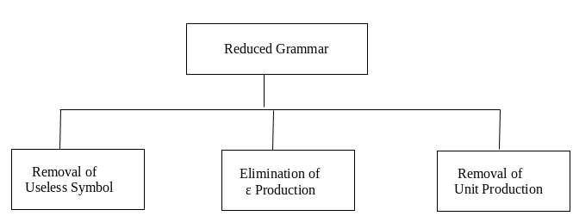
Simplification of CFG
The properties of reduced grammar are given below:
Each variable (i.e. non-terminal) and each terminal of G appears in the derivation of some word in L.
There should not be any production as X → Y where X and Y are non-terminal.
If ε is not in the language L then there need not to be the production X → ε.

Slide 53

Nullable Variable
A Nullable variable in a CFG, $G=(N,T,S,P)$ is defined as follows:
Any variable A for which P contains $A→^$ is nullable.
If P contains the production $A→B1 B2….Bn$ are nullable variable, then A is nullable.
No other variables in V are nullable.

Slide 54
Eliminate ˄ production
S→a X |Yb
X→ ˄ | S
Y→bY|b
S→aX | Yb | a^
X→^ | S
Y→bY|b
S→aX|Yb|a
X→S
Y→bY|b
Nullable variable={X}
Replacing X by ^ in all productions containing X on RHS and rewriting the production again
Removing ^ productions

Slide 55
Exercise: Eliminate ^ production
S→AC
A→aAb|˄
C→aC|a
After elimination of ^ production:
S→AC | C
A→aAb| ab
C→aC|a
S→XaX|bX|Y
X→XaX|XbX|˄
Y→ab
After elimination of ^ production:
S→ XaX | bX | Y | aX | Xa | a | b
X→ XaX |XbX | aX | Xa | a | Xb | bX | b
Y→ab

Slide 56
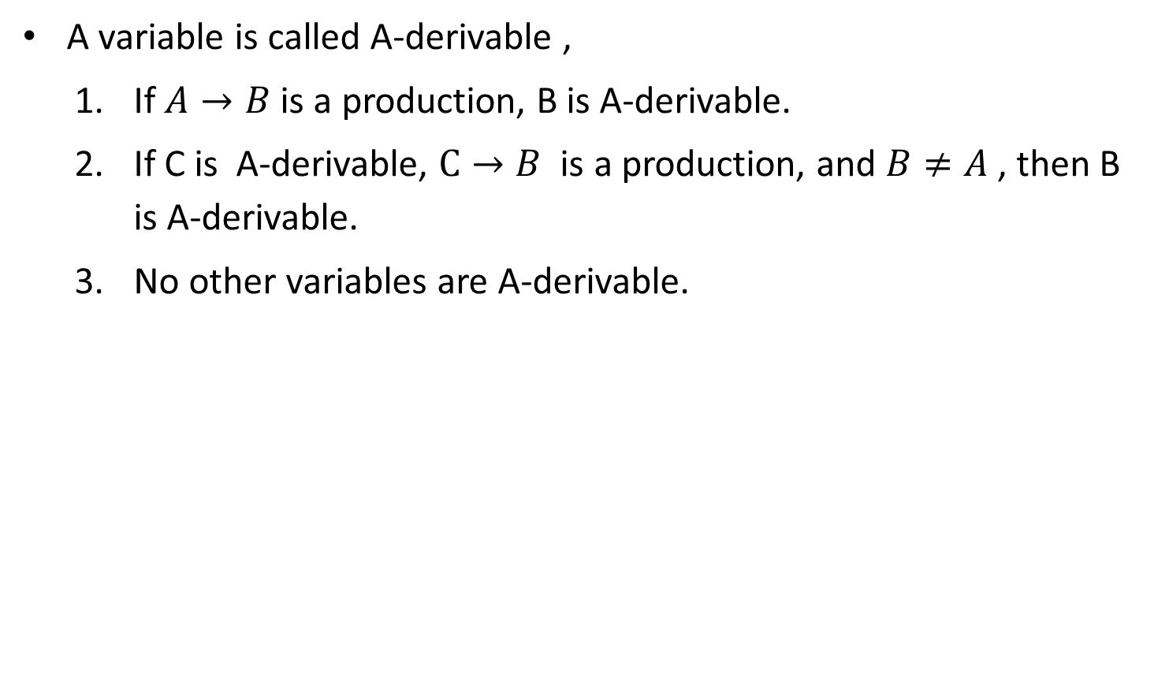
A-derivable
A variable is called A-derivable ,
If $A→B$ is a production, B is A-derivable.
If C is A-derivable, $C→B$ is a production, and $B≠A$ , then B is A-derivable.
No other variables are A-derivable.
S→A
S→B
S-derivable={A,B}
S→A
A→B
S-derivable={A,B}

Slide 57
Unit Production
A production of the form A→B is termed as unit production. Where A & B are nonterminals.

Slide 58
Elimination of unit production
S→ABA|BA|AA|AB|A|B
A→ aA|a
B→ bB|b
Unit Productions are S→A and S→B
A→aA|a
B→bB|b
S→ABA|BA|AA|AB
|aA|a
|bB|b
Removing unit productions

Slide 59
Useless Symbols
A symbol can be useless if it does not appear on the right-hand side of the production rule and does not take part in the derivation of any string. That symbol is known as a useless symbol.

Slide 60
Elimination of Useless Symbols
S→abS | abA | abB
A→ cd
B→aB
C→dc
S→abS | abA
A→ cd
C→dc
S→abS | abA
A→ cd
production ‘C->dc’ is useless because the variable ‘C’ will never occur in derivation of any string.
Production ‘B->aB’ is useless because there is no way it will ever terminate .

Slide 61
Elimination of Useless Symbols
T→aaB | abA | aaT
A→ aA
B→ab|b
C→ad
T→aaB | aaT
B→ ab|b
C→ad
T→aaB | aaT
B→ ab|b
production ‘C->ad’ is useless because the variable ‘C’ will never occur in derivation of any string.
Production ‘A->aA’ is useless because there is no way it will ever terminate .

Slide 62
Exercise
S→AB
A→ aAb
A→ab
B→bB
B→b
C→cCd
C→cd

Slide 63
CFG to CNF

Slide 64
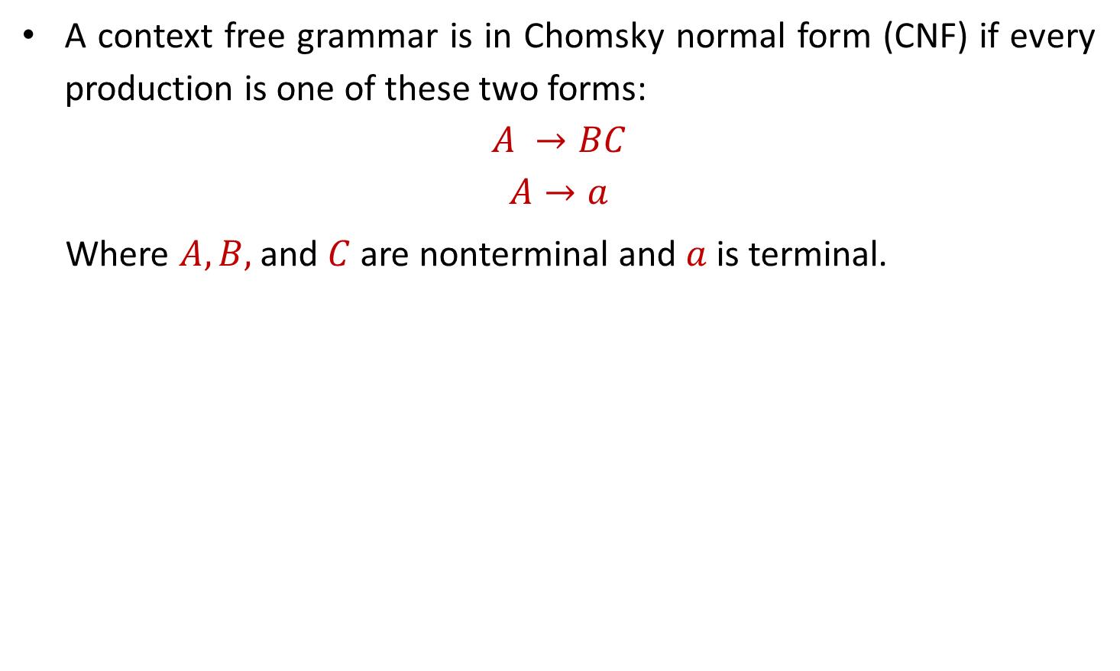
Chomsky Normal Form (CNF)
A context free grammar is in Chomsky normal form (CNF) if every production is one of these two forms:
$$A →BC$$
$$A→a$$
Where $A, B,$and $C$ are nonterminal and $a$ is terminal.

Slide 65
Converting CFG to CNF
Steps to convert CFG to CNF
Eliminate ˄-Productions.
Eliminate Unit Productions.
Restricting the right side of productions to single terminal or string of two or more nonterminals.
Final step of CNF. (shorten the string of NT to length 2)

Slide 66
Example: CFG to CNF
S→AAC
A→aAb|˄
C→aC|a
Step 1: Elimination of ^ production
Step-2: Eliminate Unit Production
Step 3: Replace all mixed string with solid NT
Step-4: Shorten the string of NT to length 2
S→AX₁ X₁→AC
S→AC|PC|a
A→PY₁ Y₁→AQ
A→PQ
C→PC|a
P→a
Q→b
|a
aC
PC
S→AAC|AC|
aAb|ab
PAQ|PQ
A→
PC|a
C→
aC|a
P→a
Q→b
Eliminate A→^
S→AAC|
AC |
C
A→aAb|
ab
C→aC|a
Unit Production is S→C
S→AAC|AC|
C
aC|a
A→aAb|ab
C→aC|a
Chomsky Normal Form

Slide 67
Example: CFG to CNF
S→aAbB
A→Ab|b
B→Ba|a
Step 1 and 2 are not required as there is no ^ and unit productions
Step-3: Replace all mixed string with solid NT
S→PAQB
A→AQ|b
B→BP|a
P→a
Q→b
Step-4 : final step of CNF
S→PT1
T1→AT2
T2→QB
A→AQ|b
B→BP|a
P→a
Q→b

Slide 68
Example: CFG to CNF
S→AA
A→B|BB
B→abB|b|bb
Step 1 is not required as there is no ^ productions
Step-2: Eliminate Unit Production:
S→AA
A→ abB|b|bb|BB
B→abB|b|bb
Step-3:Replace all mixed string with solid NT:
S→AA
A→ PQB|b|QQ|BB
B→ PQB|b|QQ
P→a
Q→b
Step-4 : Shorten the string of NT to length 2
S→AA
A→ PT1|b|QQ|BB T1→QB
B→ PT1|b|QQ
P→a
Q→b

Slide 69
Example: CFG to CNF
S→ASB|^
A→aAS|a
B→SbS|A|bb
Step-1: Eliminate ˄-Production:
S→ASB|AB
A→aAS|a|aA
B→SbS|A|bb|bS|Sb|b
Step-2: Eliminate Unit Production:
S→ASB|AB
A→aAS|a|aA
B→SbS|aAS|a|aA|bb|bS|Sb|b
Step-3:Replace all mixed string with solid NT:
S→ASB|AB
A→PAS|a|PA
B→SQS|PAS|a|PA|QQ|QS|SQ|b
P→a
Q→b
Step-4 : Shorten the string of NT to length 2
S→AB|AT1 T1→SB
A→a|PA|PU1 U1→AS
B→ SV1|PV2|a|PA|QQ|QS|SQ|b
V1→QS V2→AS
P→a
Q→b

Slide 70
Greibach Normal Form (GNF)
A context free grammar is in Greibach normal form (GNF) if every production is one of these two forms:
A start symbol generating ε. For example, S → ε.
A non-terminal generating a terminal. For example, A → a.
A non-terminal generating a terminal which is followed by any number of non-terminals. For example, S → aASB.
Greibach Normal Form is useful for proving the equivalence of cfgs and npdas. When we discuss converting a cfg to an npda, or vice versa, we will use Greibach Normal Form.

Slide 71
Greibach Normal Form (GNF)
G1 = {S → aAB | aB, A → aA| a, B → bB | b}
Is it in GNF?
Yes
G2 = {S → aAB | aB, A → aA | ε, B → bB | ε}
Is it in GNF?
No

Slide 72
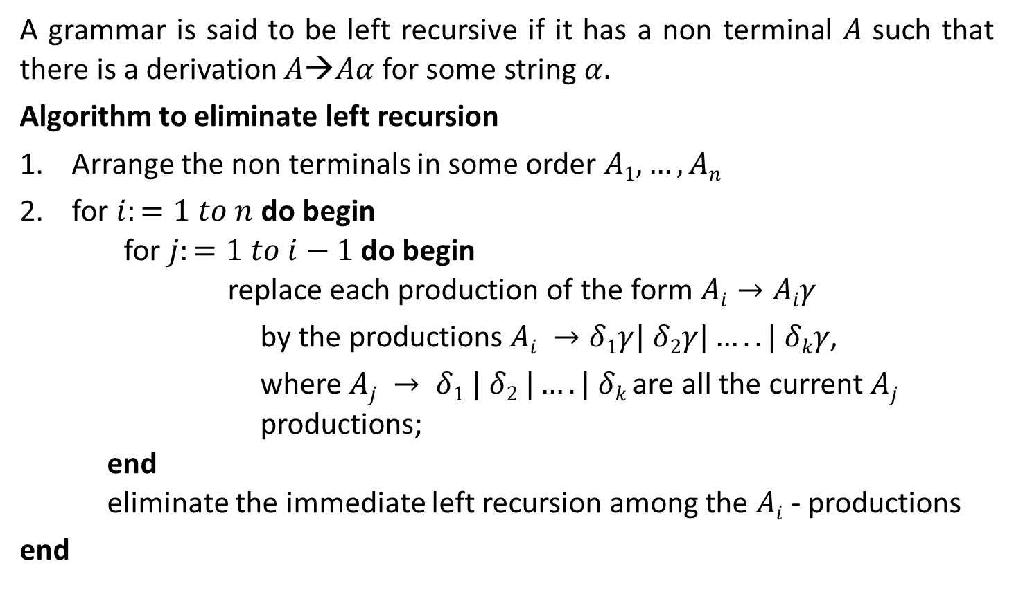
Left recursion
A grammar is said to be left recursive if it has a non terminal $A$ such that there is a derivation $A→Aα$for some string $α.$
Algorithm to eliminate left recursion
Arrange the non terminals in some order $A1,…,An$
for $i:=1 to n$ do begin for $j:=1 to i−1$ do begin replace each production of the form $Ai→Aiγ$
by the productions $Ai →δ1γ| δ2γ|…..| δkγ$,
where $Aj → δ1 | δ2 |….| δk$are all the current $Aj$ productions; end eliminate the immediate left recursion among the $Ai$ - productions
end

Slide 73


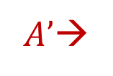






Left recursion elimination
$$A→Aα |$$
$A→$
$$β$$
$$A’$$
$$α$$
$$β$$
$|$𝜖
$A’$→
$$A’$$

Slide 74
Examples: Left recursion elimination
E→E+T | T
E→TE’
E’→+TE’ | ε
T→T*F | F
T→FT’
T’→*FT’ | ε
X→X%Y | Z
X→ZX’
X’→%YX’ | ε

Slide 75
Examples: Left recursion elimination
S→ Aa | b
A→ Ac | Sd | ε
Here, Non terminal S is left recursive because:
S→ Aa → Sda
S→ Aa | b
A→ Ac
A→
A→ ε
Now, remove left recursion
S→ Aa | b
A→ bdA’ | A’
A’→ cA’ | adA’ | ε
Aad | bd
To remove indirect left recursion replace S with productions of S
Sd
A→Ac | Aad | bd | ε
S→ Aa | b
A→Ac | Aad | bd | ε

Slide 76
Exercise
A→Abd | Aa | a
B→Be | b
A→AB | AC | a | b

Slide 77
Converting CFG to GNF
Step 1: Convert the grammar into CNF.
If the given grammar is not in CNF, convert it into CNF.
Step 2: If the grammar exists left recursion, eliminate it.
If the context free grammar contains left recursion, eliminate it.
Step 3: In the grammar, convert the given production rule into GNF form.
If any production rule in the grammar is not in GNF form, convert it.

Slide 78
Example: CFG to GNF
S → aBc
B → b
Is it in GNF?
NO
Convert it in GNF
S → aBC
B→ b
C→ c
Grammar in GNF Format

Slide 79
Example: CFG to GNF
S → XB | AA
A → a | SA
B → b
X → a
As the given grammar G is already in CNF and there is no left recursion, so we can skip step 1 and step 2 and directly go to step 3.
The production rule A → SA is not in GNF, so we substitute S → XB | AA in the production rule A → SA as:
S → XB | AA
A → a | XBA | AAA
B → b
X → a

Slide 80
Example: CFG to GNF
The production rule S → XB and B → XBA is not in GNF, so we substitute X → a in the production rule S → XB and B → XBA as:
Remove null production C → ε
S → aB | AA
A → aC | aBAC | a | aBAC → AAC | AA
B → b
X → a
S → aB | AA
A → a | aBA | AAA
B → b
X → a
The production rule S → AA is not in GNF, so we substitute A → aC | aBAC | a | aBA in production rule S → AA as:
Remove left recursion (A → AAA)
S → aB | AA
A → aC | aBAC
C → AAC | ε
B → b
X → a
S → aB | aCA | aBACA | aA | aBAA A → aC | aBAC | a | aBA
C → AAC
C → aCA | aBACA | aA | aBAA
B → b
X → a

Slide 81
Example: CFG to GNF
S → aB | aCA | aBACA | aA | aBAA A → aC | aBAC | a | aBA
C → AAC
C → aCA | aBACA | aA | aBAA
B → b
X → a
The production rule C → AAC is not in GNF, so we substitute A → aC | aBAC | a | aBA in production rule C → AAC as:
S → aB | aCA | aBACA | aA | aBAA
A → aC | aBAC | a | aBA
C → aCAC | aBACAC | aAC | aBAAC
C → aCA | aBACA | aA | aBAA
B → b
X → a

Slide 82
Example: CFG to GNF
S → Ab
A → aS
A → a
S → aSB| aB
A → aS
A → a
B→ b
S → aSB| aB
B→ b
S → aSb| ab
A → aS
A → a
Useless Symbols
S → aSB| aB
A → aS
A → a
B→ b
GNF
Why?
Is it in GNF?
No

Slide 83
Backus-Naur Form (BNF)
BNF is one of the notation techniques for context free grammar.
It is often used to describe syntax of the language used in computing.
Variables written between <..> are non terminals.
Vertical bar ‘|’ indicating a alternate choice.
[…], which is used to enclosed an optional specification.
Example:
<exp>=<exp> + <term> | <term>
<term>=<term> * <factor> | <factor>
<factor>=<factor> ^ <primary> | <primary>
<primary>=<id> | <const>
<id>=<letter>
<const>=[+/-]<digit>
<letter>=a | b | c |……| z
<digit>=0 | 1 |………….| 9

Slide 84
Decision Properties of CFG
Is a given string in a CFL?
Is a CFL empty?

Slide 85
Decision Properties of CFG
Is a given string in a CFL?
1) If we are given the CFL as a PDA, we can answer this simply by executing the PDA.
2) If we are given the language as a grammar, we can either
Convert the grammar to a PDA and execute the PDA, or
Convert the grammar to Chomsky Normal Form and parse the string to find a derivation for it.

Slide 86
Decision Properties of CFG
Is a CFL empty?
Detect whether a variable is nullable.
Determine if the grammar’s start symbol is nullable.

Slide 87
Decision Properties of CFG
No algorithm exists to determine if
Two CFLs are the same.
Note that we were able to determine this for regular languages.
Two CFLs are disjoint (have no strings in common).

Slide 88
Union, Concatenation & Kleene’s of CFG

Slide 89
Union, Concatenation & Kleene’s of CFG
Theorem:- If L₁ and L₂ are context - free languages, then the languages L₁ U L₂, L₁L₂ , and L₁* are also CFLs.

Slide 90
Union
If L1 and If L2 are two context free languages, their union L1 ∪ L2 will also be context free.
L1 = { a^{n}b^{n}c^{m} | m >= 0 and n >= 0 } and L2 = { a^{n}b^{m}c^{m} | n >= 0 and m >= 0 } L3 = L1 ∪ L2 = { a^{n}b^{n}c^{m} ∪ a^{n}b^{m}c^{m} | n >= 0, m >= 0 }
L3 is also Context Free Language.

Slide 91
Concatenation
If L1 and If L2 are two context free languages, their union L1 . L2 will also be context free.
L1 = { a^{n}b^{n} | n >= 0 } and L2 = { c^{m}d^{m} | m >= 0 } L3 = L1.L2 = { a^{n}b^{n}c^{m}d^{m} | m >= 0 and n >= 0}
L3 is also Context Free Language.

Slide 92
Intersection and complementation
If L1 and If L2 are two context free languages, their intersection L1 ∩ L2 need not be context free.

Slide 93
Closure Property Summary
Context-free languages are closed under −
Union
Concatenation
Kleene Star operation
Context-free languages are not closed under −
Intersection
Complement

Slide 94
End of Unit - 3

